Slide 1
Transcendental Functions Session 17-19
Course : MATH 6031 - Calculus
Year : 2021

Slide 2

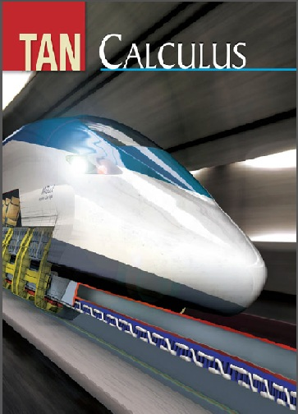
These slides have been adapted from: Dale Varberg, Edwin Purcell, Steve Rigdon. 2007. Calculus. Prentice Hall. ISBN: 978-0132306331. Soo.T.Tan. Calculus. 2010. Brooks/Cole. ISBN-13: 978-0-534-46579-7
Acknowledgement

Slide 3

Learning Objectives
LO 3:
Explain the properties of integral to describe geometric and physical problems, and
other applications.

Slide 4
Content
1
The natural logarithm function
2
Inverse function and Their derivatives
3
The natural exponential function
4
General exponential and logarithmic functions

Slide 5
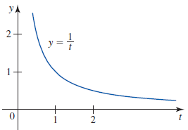
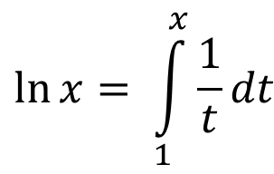

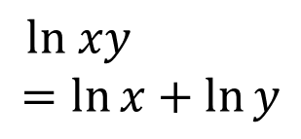


The Natural Logarithmic Function
$$\ln{\frac{x}{y}}$$
$$=\ln{x −\ln{y}}$$
$$\ln{1=0}$$
$$\ln{x= \int_{1}^{x}{\frac{1}{t}dt}}$$
$$\ln{x^{r}}$$
$$=r\ln{x}$$
$ln xy$
$$=\ln{x+\ln{y}}$$

Slide 6
Inverse Function
Definition
A function g is the inverse of the function f if
$f\left(g\left(x\right)\right)=x$ for every x in the domain of g and
A function g is the inverse of the function f if
𝑓(𝑔(𝑥))=𝑥 for every x in the domain of g and
Definition
Equivalently, g is the inverse of f if the following condition is satisfied:
Finding Inverse
1. Write $y=f(x)$.
1. Write 𝑦=𝑓(𝑥).
$g\left(f\left(x\right)\right)=x$ for every x in the domain of f
𝑔(𝑓(𝑥))=𝑥 for every x in the domain of f
$y=f\left(x\right)$ if and only if $x=g(y)$
𝑦=𝑓(𝑥) if and only if 𝑥=𝑔(𝑦)
for every x in the domain of f and for every y in its range.
2. Solve this equation for in terms of (if possible).
3. Interchange x and y to obtain $y=f^{−1}(x)$.
3. Interchange x and y to obtain 𝑦=𝑓^(−1) (𝑥).

Slide 7
The Derivative of an Inverse Function
Theorem
Let f be differentiable on its domain and have an inverse function $g=f^{−1}(x)$.
Then the derivative of is given by
$$g^{′}\left(x\right)=\frac{1}{f^{′}[g(x)]}$$
provided that $f^{′}\left[g\left(x\right)\right]≠0$
Let f be differentiable on its domain and have an inverse function 𝑔=𝑓^(−1) (𝑥).
Then the derivative of is given by
𝑔^′ (𝑥)=1/(𝑓^′ [𝑔(𝑥)])
provided that 𝑓^′ [𝑔(𝑥)]≠0
Example
Let $f\left(x\right)=x^{2}$and $g$ is the inverse of f.
The point (2,4) does lie on the graph of f.
Then
$$g^{′}\left(4\right)=\frac{1}{f^{′}[g(4)]}=\frac{1}{f′(2)}={\left.\frac{1}{2x}\right|}_{x=2}=\frac{1}{2(2)}=\frac{1}{4}$$
Let 𝑓(𝑥)=𝑥^2 and 𝑔 is the inverse of f.
The point (2,4) does lie on the graph of f.
Then
𝑔^′ (4)=1/(𝑓^′ [𝑔(4)])=1/(𝑓′(2))=├ 1/2𝑥┤|_(𝑥=2)=1/(2(2))=1/4

Slide 8







The Natural Exponential Function
The natural exponential function, exp, is defined by the rule
$$x=exp\left(y\right)= e^{y}↔y=\ln{x}$$
Properties of the exponential function:
$$\ln{e}=1$$
$$e^{\ln{x}}=x, x>0$$
$$\ln\left(e^{y}\right)=y$$
$$\frac{e^{x}}{e^{y}}=e^{x−y}$$
$e^{x}$ $e^{y}=e^{x+y}$
$${{(e^{x})}^{r}=(e}^{rx})$$
Notes:
Buat slide yang natural logarithm

Slide 9
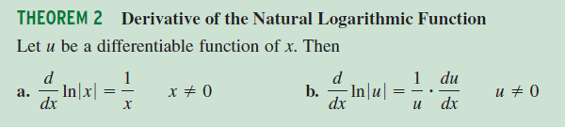
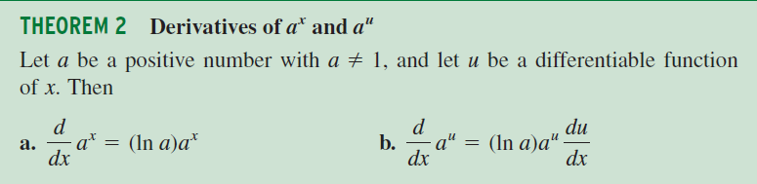
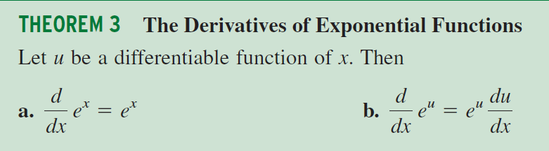
Derivatives of The Natural Logarithm Functions

Slide 10
Example 8

Slide 11



Example 9

Slide 12
Integration Logarithmic Functions
Theorem
Let u = g(x), where g is differentiable, and suppose that g(x) ≠ 0. Then
Example

Slide 13
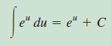
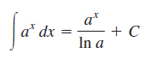
Integration of the Natural Exponential Function
Theorem
Let u be a differentiable function of x
Theorem
The integral of a^{x} where a > 0 and a ≠ 1:

Slide 14
Dale Varberg, Edwin Purcell, Steve Rigdon. 2007. Calculus. Prentice Hall. ISBN: 978-0132306331.
Dale Varberg, Edwin Purcell, Steve Rigdon. 2014. Calculus Early Transcendentals. Pearson New International Edition. ISBN: 978-1-292-04268-8
Soo.T.Tan. 2010. Calculus. Brooks/Cole. ISBN-13: 978-0-534-46579-7

